Slide 1
Disaster & Innovation: the Case of Large-Scale Wildfire
2022 Fall. National Innovation System
Research Prospectus
Hyeonbin Park
November 1, 2022

Slide 2
Table of Contents
Introduction: Research Issue
Disaster and Innovation
Research Questions
Methods
Bibliography
1

Slide 3
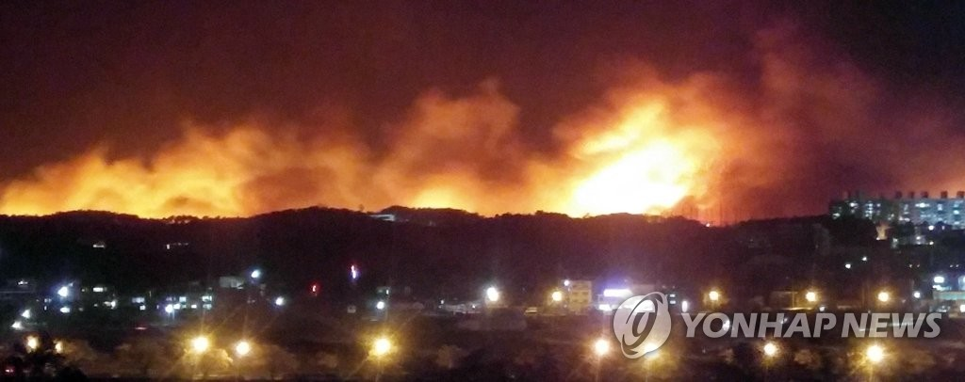
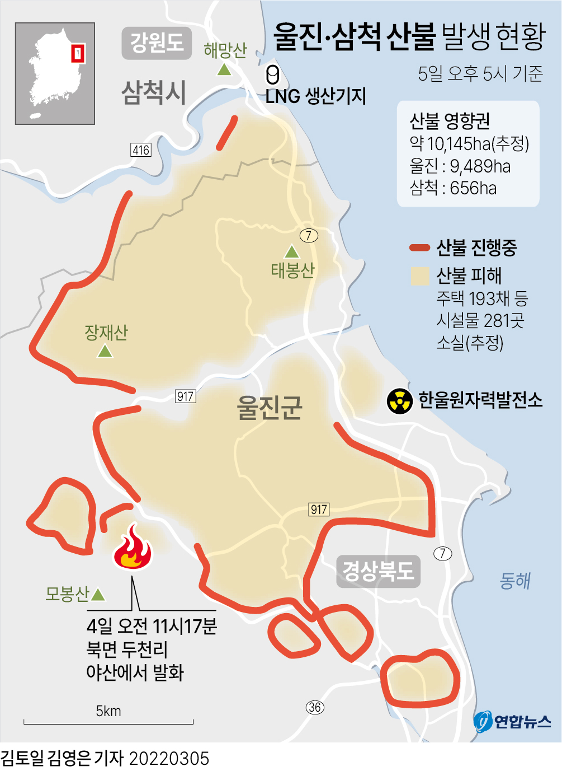
1. Introduction: Research Issue
2019 April Gangwon Province Wildfires
2022 March Uljin-Samcheok Wildfires
2

Slide 4
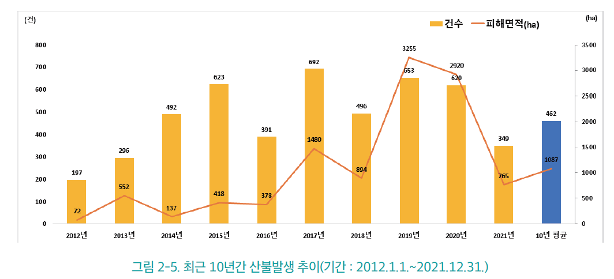
1. Introduction: Research Issue
Wildfire Statistics
3

Slide 5
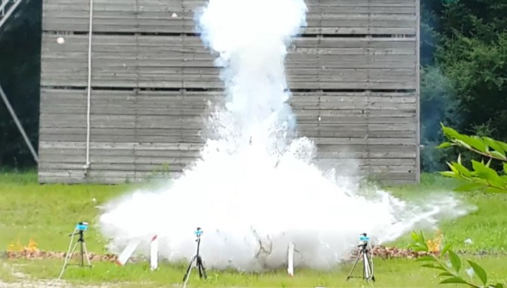
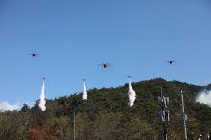
1. Introduction: Research Issue
“Status and future tasks of cutting-edge ICT technology for preventing and responding to large-scale wildfires” (National Assembly Research Service 2022. 5. 16)
The forest fire response system, which is currently divided into the Fire Agency and the Forest Service, needs to be reorganized.
2019 testing for extinguisher drop by using drones
2022 training for wildfire response
4

Slide 6
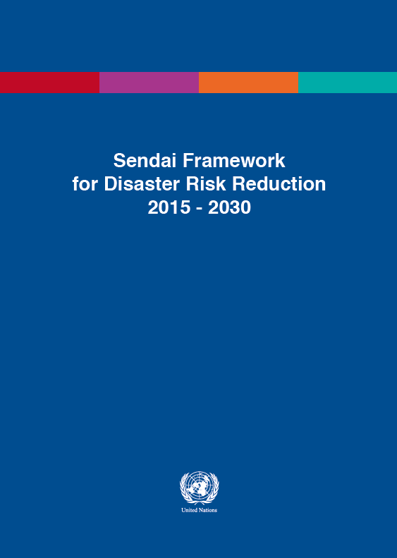
2. Disaster and Innovation
- Disaster and Innovation in UN
Through interdisciplinary concepts, technology, improving policy-making processes, community-based innovation, and inclusive and participatory approaches (UNISDR 2016)
Which factors are fit to specific cases? -> should be contextualized
5

Slide 7
2. Disaster and Innovation
Different types of innovation, other than “technological” (Salter and Alexy 2014)
Service Innovation
Involving new ways of bringing together information and creative routines (Gallouj and Weinstein 1997)
And artifacts (maintenance and repair), data, symbols; e.g financial service, rescue service (Malerba and Adams 2014)
Social and cultural norms are important to innovation in services (Mile 2005; Tether 2005)
6

Slide 8
2. Disaster and Innovation
Learning from Disaster (Knowles 2014)
- “After Innovation, turn to Maintenance” (Russel and Vinsel 2018)
- Organizational changes in disaster settings (Ross 1976)
7

Slide 9
3. Research Questions
In what sense, is there any organizational lock-in in wildfire response systems in South Korea?
Which systemic approach to innovation may work well for wildfire responses? (in regard to the entanglements of technology, actors, and institutions)
8

Slide 10
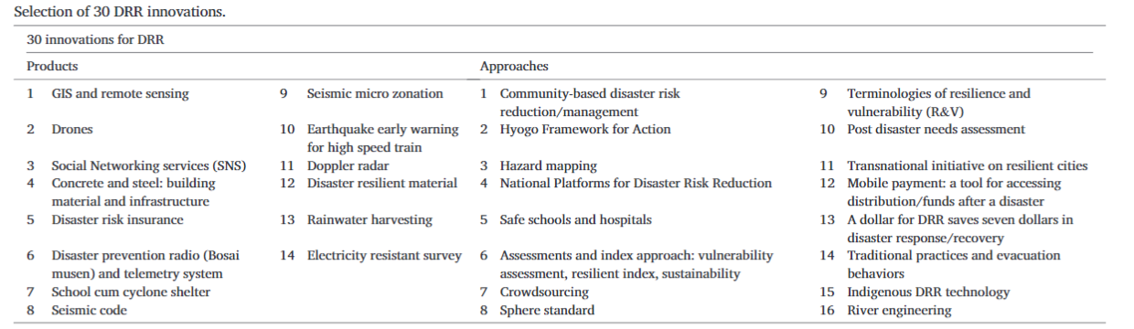
4. Methods
Interviewing
Organizational issues in Korea Forestry Service/ National Fire Agency
Surveying (e.g. Izumi et al. 2019)
9

Slide 11
5. Bibliography
Gallouj, F., & Weinstein, O. (1997). Innovation in services. Research policy, 26(4-5), 537-556.
Izumi, T., Shaw, R., Djalante, R., Ishiwatari, M., & Komino, T. (2019). Disaster risk reduction and innovations. Progress in Disaster Science, 2, 100033.
Knowles, S. G. (2014). Learning from disaster? The history of technology and the future of disaster research. Technology and Culture, 55(4), 773-784.
Malerba, F., & Adams, P. (2014). Sectoral Systems of Innovation. In Mark Dodgson, David M. Gann, and Nelson Philips (eds.). The Oxford Handbook of Innovation Management. Oxford University Press.
Mile, I. (2005). Innovation in Services. In J. Fagerberg, D. Mowery, and R. Nelson (eds.). The Oxford Handbook of Innovation. Oxford University Press, 433-58.

Slide 12
5. Bibliography
Salter, A., & Alexy, O. (2014). The Nature of Innovation. In Mark Dodgson, David M. Gann, and Nelson Philips (eds.). The Oxford Handbook of Innovation Management. Oxford University Press.
Tether, B. S. (2005). Do Services Innovate (Differently)?: Insights from the European Innobarometer Survey. Industry and Innovation, 12(2): 153-84.
Russell, A. L., & Vinsel, L. (2018). After innovation, turn to maintenance. Technology and Culture, 59(1), 1-25.
UNISDR. (2016). Sharing innovations to improve implementation and reporting of the Sendai framework for disaster risk reduction 2015–2030. Short concept note: Work Stream 3, Working Group 3.

Slide 13
Image Sources
Figure 1. https://www.yna.co.kr/view/AKR20190404178551062
Figure 2. https://www.yna.co.kr/view/GYH20220305000700044
Figure 3. 국립산림과학원. 2021 산림재해백서
Figure 4. https://www.dongascience.com/news.php?idx=27889
Figure 5. https://m.korea.kr/news/pressReleaseView.do?newsId=156495830#pressRelease

Slide 14
Thank you for listening!
2022 Fall. National Innovation System
Research Prospectus
Hyeonbin Park
November 1, 2022

